Slide 1
Community Interview in the community.
By: Andrew Miller

Slide 2
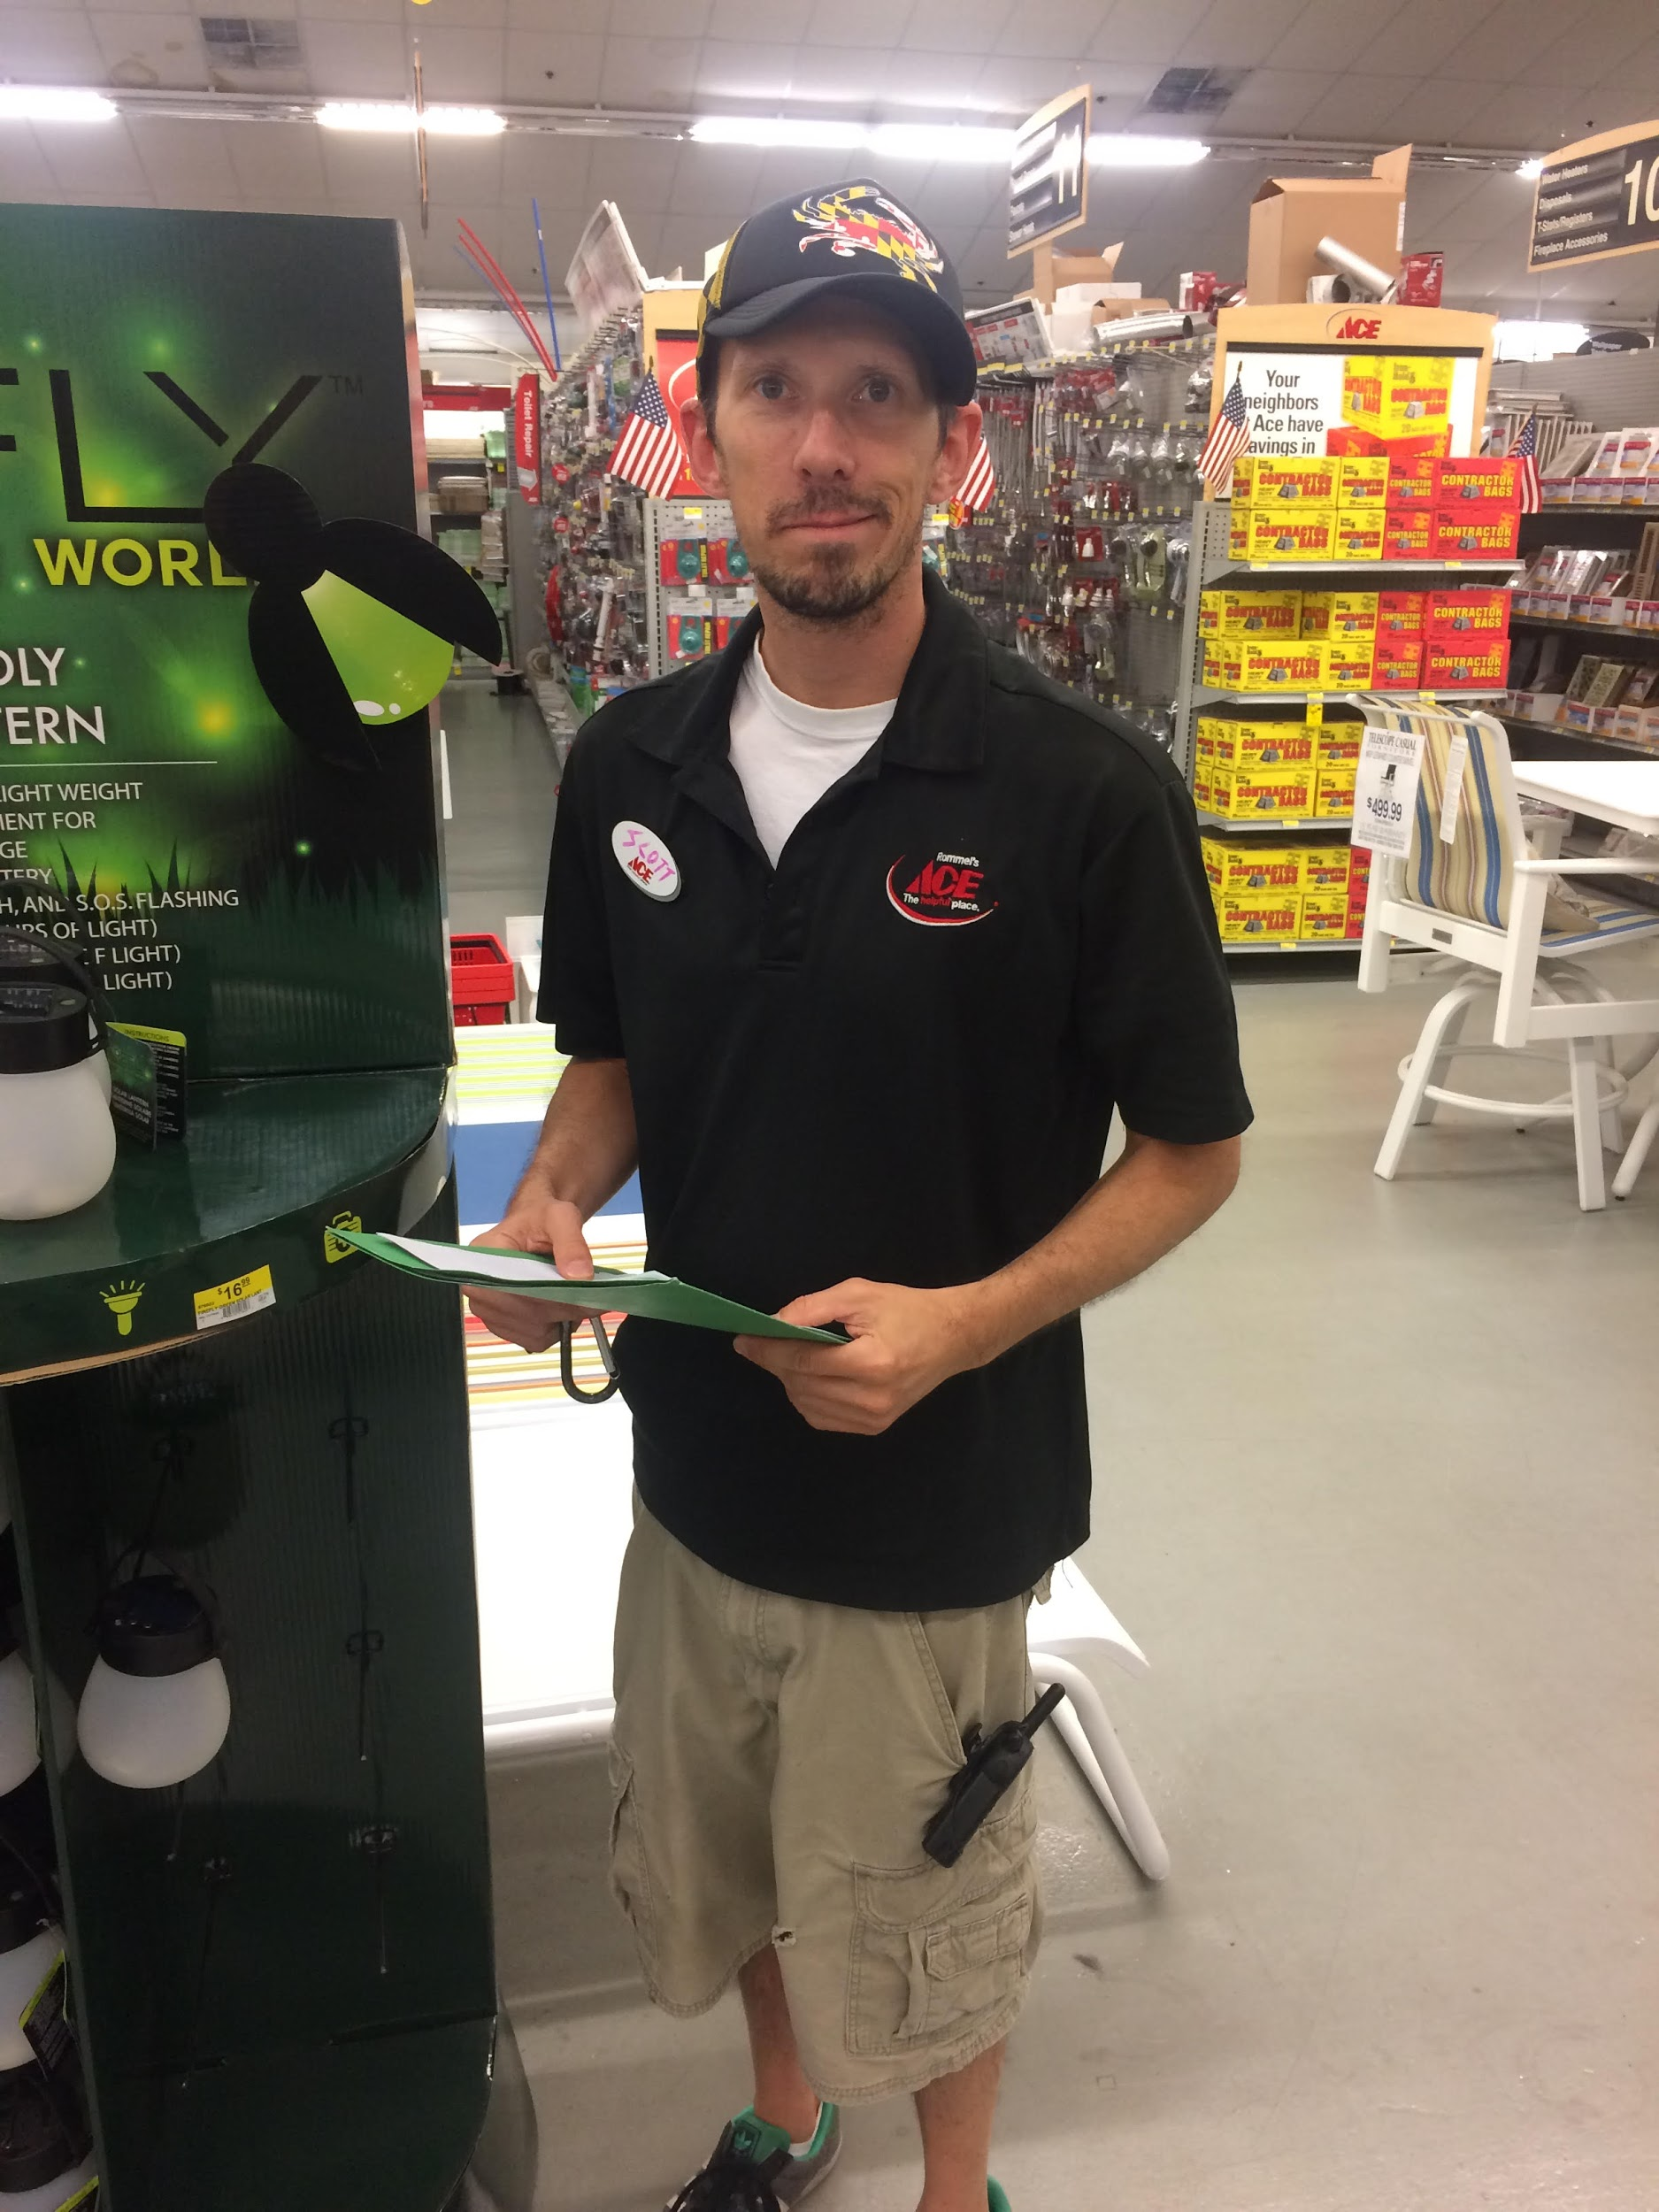
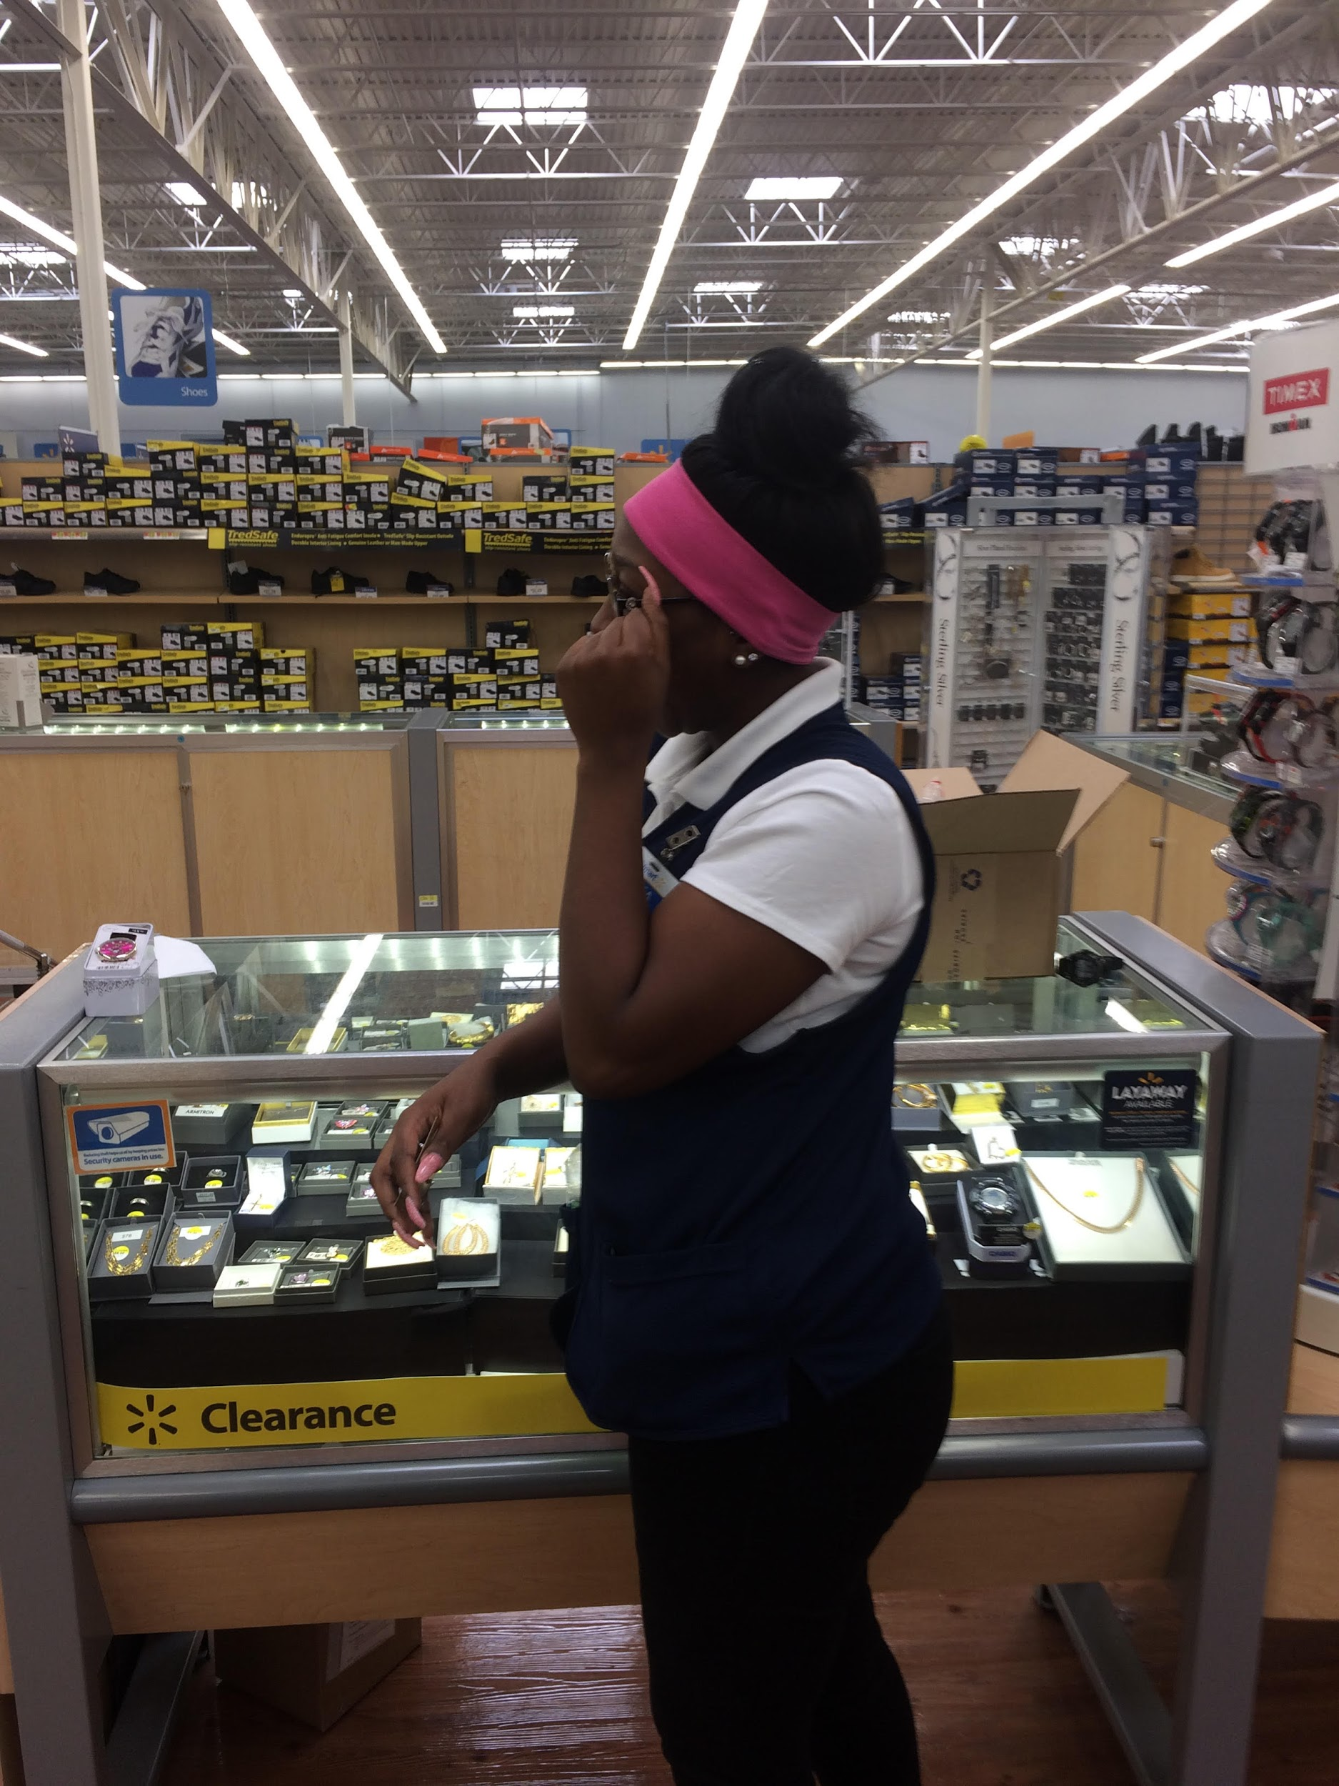
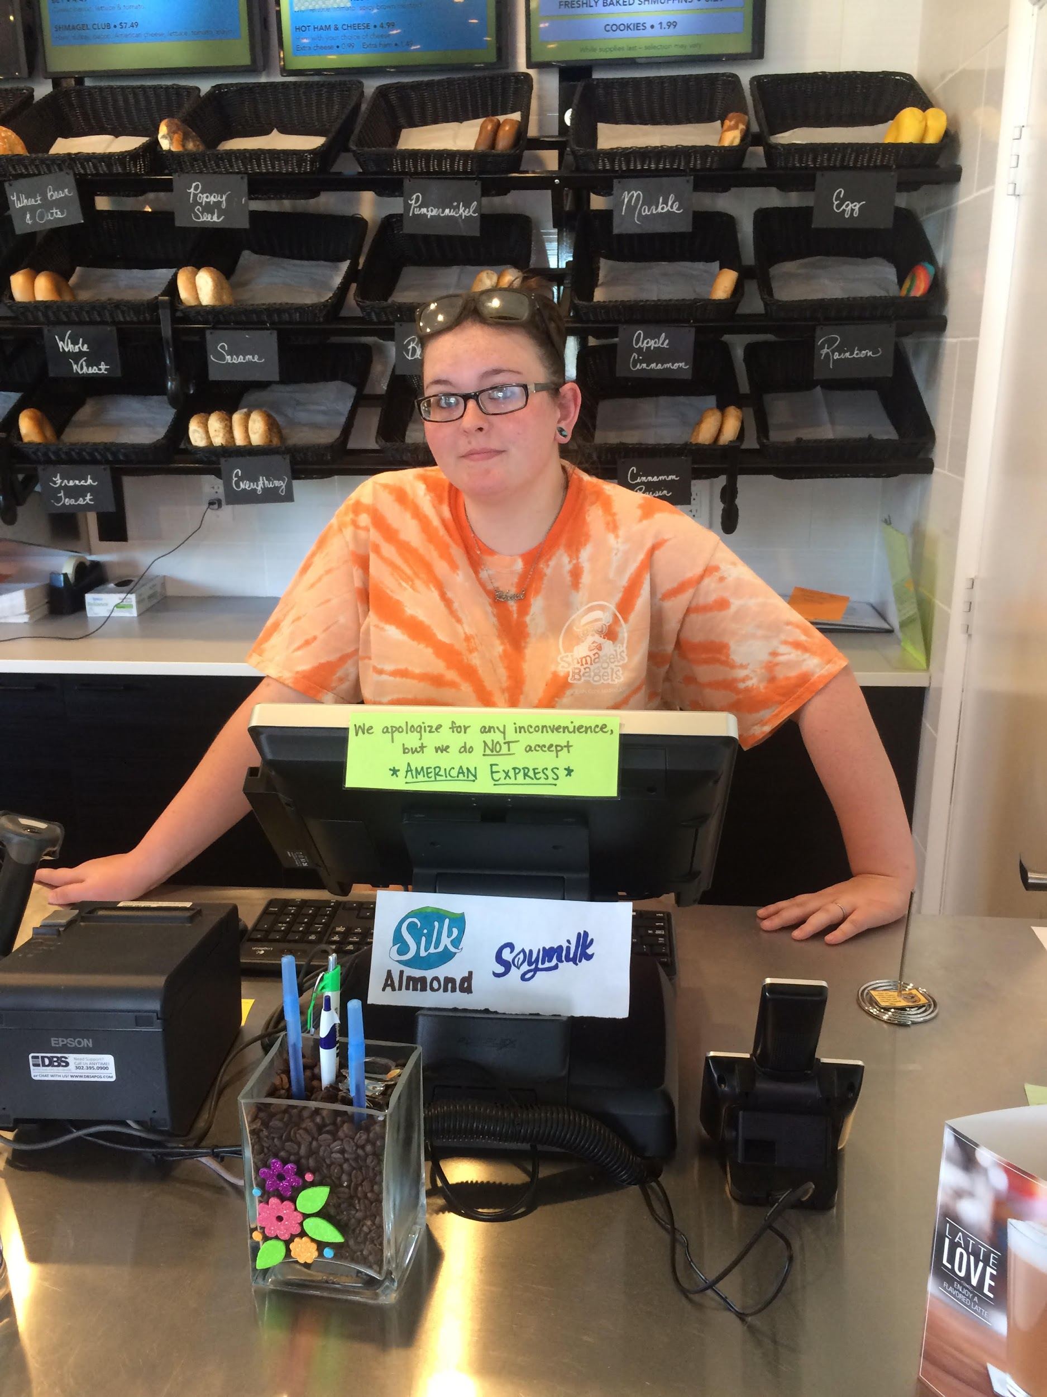
Pictures
Scott
Gnea
Rebecca

Slide 3
Background
Scott: Assistant Manager at Rommel’s ACE Hardware store on 68th street in Ocean City. Has been working there for 5 years. Lives in Ocean City, and has a dog. He is a male human.
Gnea: Employee at Walmart, worked there for 2 years, did not say where she lived other than that she doesn’t live in the area. She is a female human.
Rebecca: Has been working at the TCBY frozen yogurt restaurant as a manager. She said that she has been working there for a long time. Lives in the Snowhill area. She is also a female human.

Slide 4
Why were these people chosen?
Why was Scott chosen to be a participant in this interview process? He is one of my bosses at work and I thought it would be best to get someone from the Ocean City area to talk about the problems they see in Ocean City.
Why was Gnea picked? I was looking around walmart for someone in a management position and I found a guy who worked at walmart but recommended that I look for her in the jewelry section so I did, and I found her then asked her some questions about problems that she sees in the area.
I choose Rebecca to be the last person that I interviewed because she was a manager whom I didn’t know and she did not live in the immediate area, so I thought it would be best to ask her about problems in Snowhill that she thinks needs to be fixed.

Slide 5
Problems
Scott: Trash on streets, traffic, loud people, narwhals, and gas prices being too high.
Gnea: Human trafficking, taxes, and high gas prices.
Rebecca: Gas, littering.
Problems that can be fixed: Trash on streets, traffic, and high gas prices.
Problems that cannot be fixed: Narwhals, Human trafficking.

Slide 6
How can the fixable problems mentioned above be fixed?
Trash: Can use autonomous robots to go around the edges of the street to remotely clean up trash, or enforce more laws that are against littering on the streets.
High Gas prices: Find other and better ways of powering cars, such as electric batteries, hydrogen fuel cells, ethanol, compressed air, water, biomass, and vegetable oil.
Traffic: Create more autonomous cars that follow street rules so that traffic can flow seamlessly, create more roads and bridges, enforce more rules of the road. Or for the crazier people, flying cars. Or don’t drive and instead bike, walk, run, jog, swim, or ride a boat or use a kayak to get where you need to go.

